Slide 1
Madison Connecticut
Madison Coastal Resiliency Commission
David Anderson, Director of Planning & Economic Development
Tom Banisch, First Selectman
October 31, 2019

Slide 2
Presentation Summary
Background
CIRCA Technical Assistance Meeting
Process Leading to Commission Formation
Commission Charge & Structure
Where We’re Going

Slide 3
Background
David Anderson, AICP
Director of Planning & Economic Development for the Town of Madison since 2012
Former Planning and Zoning Administrator for the Town of East Haven from 2008-2012
In East Haven for Tropical Storm Irene and in Madison for Superstorm Sandy
Tom Banisch
Madison First Selectman since 2015

Slide 4
Background
Madison received a grant under the Community Development Block Grant Disaster Recovery Program (CDBG-DR) for coastal resilience planning in Branford, Milford, and Madison.
Worked with Milone & MacBroom to develop the Town of Madison Coastal Resilience Plan, which was adopted in June 2016.
Other plans:
SCRCOG Multi-Jurisdiction Hazard Mitigation Plan
Regional Framework for Coastal Resilience
Plan of Conservation & Development
Excellent planning documents, but recommendations within the plans were not being implemented

Slide 5
Background
Experiencing more frequent flooding from routine, non-storm related events.
Planning & Zoning Commission (PZC) amended regulations to ease the process for existing homes to be raised up to two feet above the Base Flood Elevation (BFE)
PZC recommended the Board of Selectmen amend the Flood & Erosion Control Ordinance to require a look-back period for the substantial improvement calculation and to require first floor elevations of two feet above BFE
Board of Selectmen requested a presentation on the anticipated impacts of sea level rise and we contacted CIRCA to assist us.

Slide 6
CIRCA Technical Assistance Meeting
Preparing for a successful meeting:
Get the decision makers all in the same room
Joint meeting of the Planning & Zoning Commission and Board of Selectmen, State Representative and State Senator participation, and public outreach to get people there.
Bring the issue home
Worked with CIRCA to develop specific examples of areas in Madison that will be impacted by sea level rise
Get press coverage
The Madison Technical Assistance Meeting was covered by the local newspaper and filmed for public television

Slide 7
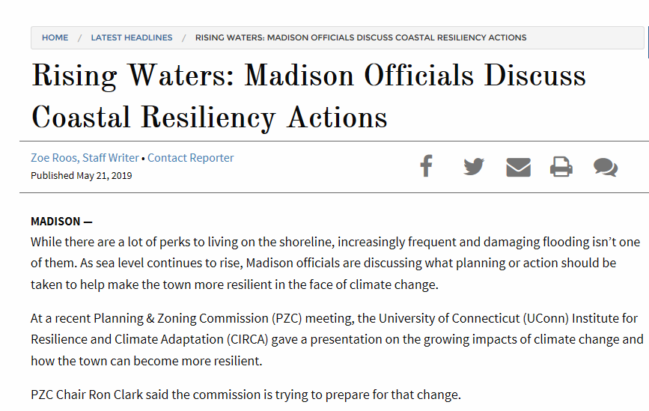
CIRCA Technical Assistance Meeting

Slide 8
CIRCA Technical Assistance Meeting
Key take-away points from the Madison meeting:
Present problems and solutions under a manageable framework
Zones of Shared Risk Concept (neighborhood level)
Explain the science, but move beyond it
People can get hung up on whether 50cm by 2050 is really going to happen. Public Act 18-82 requires municipalities to plan for that possibility. Leaning on PA 18-82 can help get over the hurdle of those questioning the science.
Have a next step identified for discussion at the end of the meeting
Madison moved towards establishing a Coastal Resiliency Commission, but other municipalities may pursue a different outcome.

Slide 9
Commission Formation
Key Factors Leading to Commission Formation:
Plans were sitting on the shelf and not being implemented
The existing board and commission structure did not allow for sufficient focus on the issue – busy doing other things
Establishing a new commission elevated the dialogue around the issue and created a greater sense of community awareness
Multiple residents expressed interest in helping out

Slide 10
Commission Formation
Timeline:
May 2, 2019 – CIRCA Technical Assistance Meeting
May 16, 2019 – Draft Charge Presented to PZC
June 5, 2019 – Draft Charge Presented to BOS
June 24, 2019 – Town Meeting Establishing Commission
September 23, 2019 – Madison Coastal Resiliency Commission members formally appointed by the Board of Selectmen
Take advantage of momentum from technical assistance meeting
Reach outside the regular board and commission nomination process
Continue working with the press

Slide 11
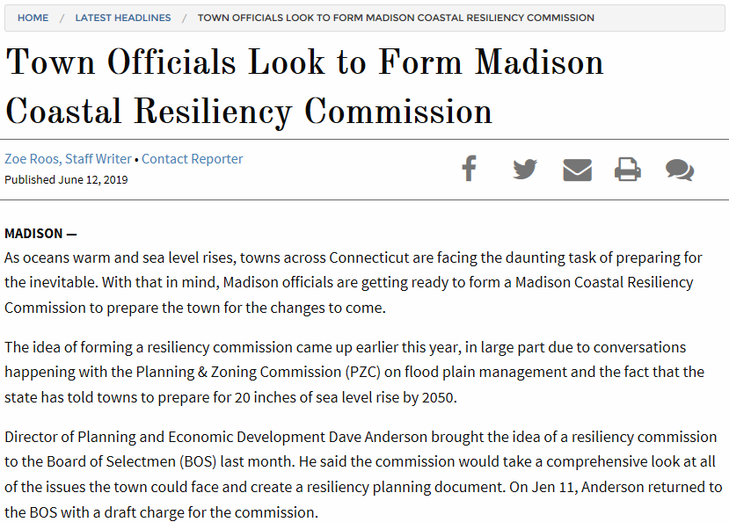
Commission Formation

Slide 12
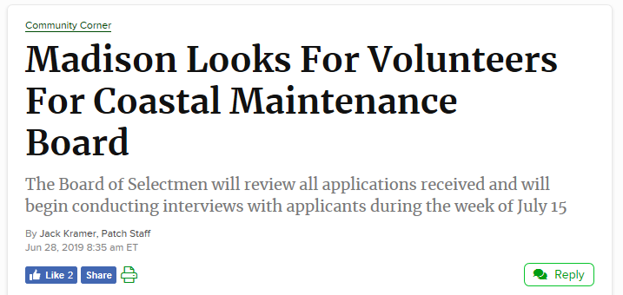
Commission Formation

Slide 13
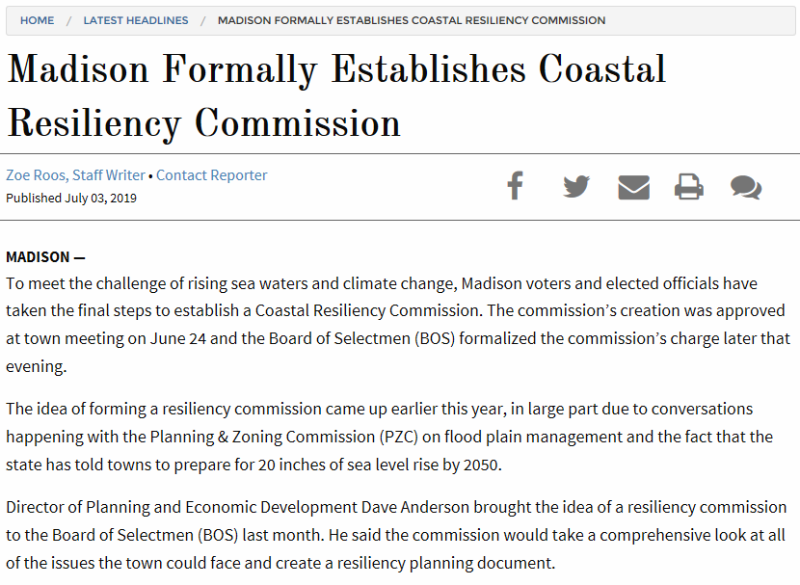
Commission Formation

Slide 14
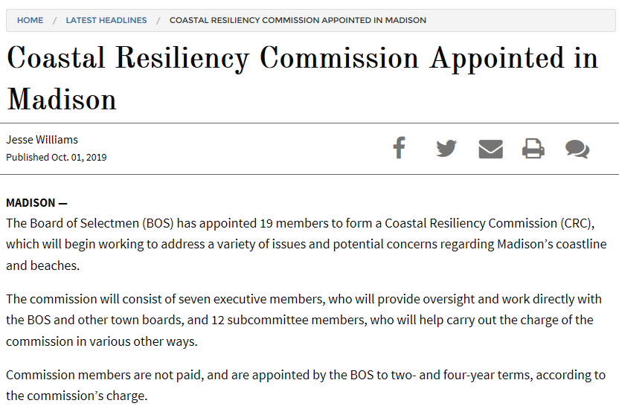
Commission Formation

Slide 15
Commission Charge & Structure
Charge:
The Madison Coastal Resiliency Commission shall be charged with evaluating the impacts of climate change and sea level rise on the Town of Madison, and shall develop a Resiliency Plan to formulate a resiliency and adaptation strategy to address potential impacts to roads, municipal parks and facilities, other critical municipal infrastructure, public and private onsite septic systems, and emergency response services. The Commission shall also conduct educational and public outreach activities to communicate its findings and recommendations, and shall provide budgetary recommendations to the Board of Selectmen and Board of Finance. The Madison Coastal Resiliency Commission shall report directly to the Board of Selectmen in carrying out its duties.

Slide 16
Commission Charge & Structure
In executing its charge, the Madison Coastal Resiliency Commission shall:
Work closely with appropriate State agencies, including the Connecticut Institute for Resilience and Climate Adaptation (CIRCA) and the Department of Energy & Environmental Protection (DEEP), to assist in evaluating the projected impacts of climate change and sea level rise;
Engage technical consultants as needed to assist in the execution of this charge;
Conduct an initial public educational event after an initial six (6) month study obligation to understand what challenges the Town of Madison is expected to face;
Within eighteen (18) months, develop a Resiliency Plan for consideration and adoption by the Board of Selectmen;
Upon adoption of the initial Resiliency Plan, propose capital projects for inclusion in the Town’s 5-Year Capital Improvement Program (CIP);
Provide input into the Plan of Conservation and Development (POCD), Hazard Mitigation Plan, and Board of Selectmen Strategic Plan update processes;
Hold at least one public educational event annually, and interface with community stakeholders on an ongoing basis;
Provide ongoing quarterly updates to the Board of Selectmen.

Slide 17
Commission Charge & Structure
Key components of the charge:
Emphasis on municipal assets, while also including consideration for private septic systems
Don’t want to elevate a section of road and ignore septic problems due to recurring flooding
Forming a “new” resiliency plan.
2016 Coastal Resiliency Plan will be used to form the basis of the plan and will be amended and expanded upon
Even more emphasis on community involvement in the plan development process
Focus on coordination with Capital Improvement Plan (CIP), Hazard Mitigation Plan, Plan of Conservation & Development (POCD), and Board of Selectmen Strategic Plans
Emphasis on ongoing communication to the Board of Selectmen and general public

Slide 18
Commission Charge & Structure
Commission Structure:
Nineteen (19) Members!!!
Original intention was to have seven (7) members, but the solicitation process resulted in over twenty high-quality candidates.
7 Executive Committee members and an additional 12 members serving on subcommittees
Three subcommittees
Technical – will be focused on resiliency solutions
Communication – will be focused on soliciting input from and disseminating information to the public
Policy – will be focused on coordinating recommendations with other municipal policies and regulations
Serving as a member of the Commission
Municipal staff and town residents working together

Slide 19
Where We’re Going
Held the first meeting of the Madison Coastal Resiliency Commission Executive Committee on October 22, 2019
Convening the entire Commission on November 19, 2019 to get everybody together
Inviting CIRCA to help reframe the issue and ensure all members are up to speed on the basics
Next steps:
Determine subcommittee appointments
Thorough review and evaluation of 2016 Coastal Resiliency Plan
Determine technical assistance needs
Formulate budget request for FY 20-21

