Slide 1
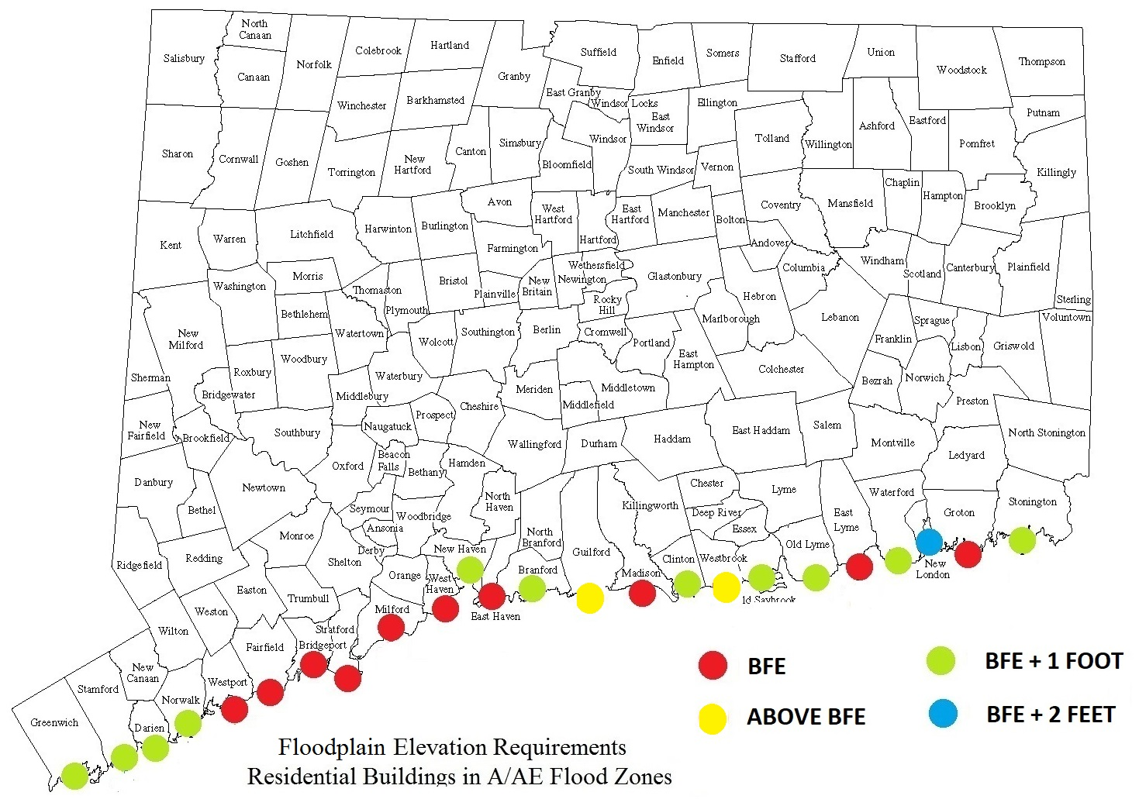
Towns, Cities, and Coastal Resilience
Joseph A. MacDougald
Professor-in-Residence and Executive Director
Center for Energy & Environmental Law
University of Connecticut School of Law

Slide 2
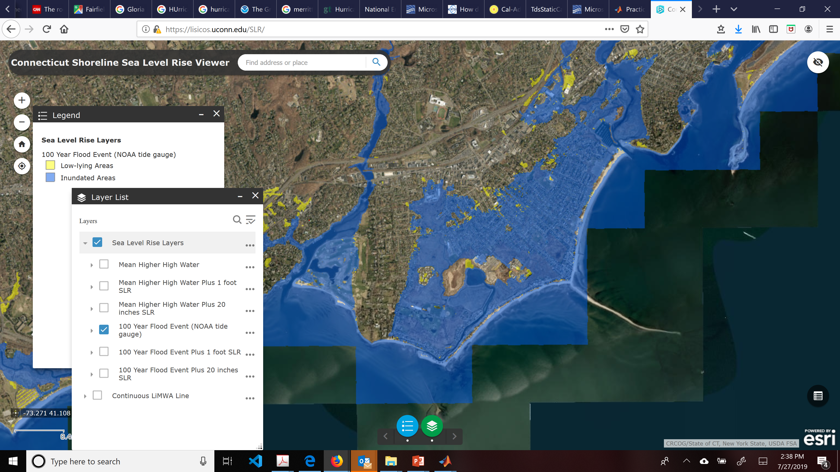
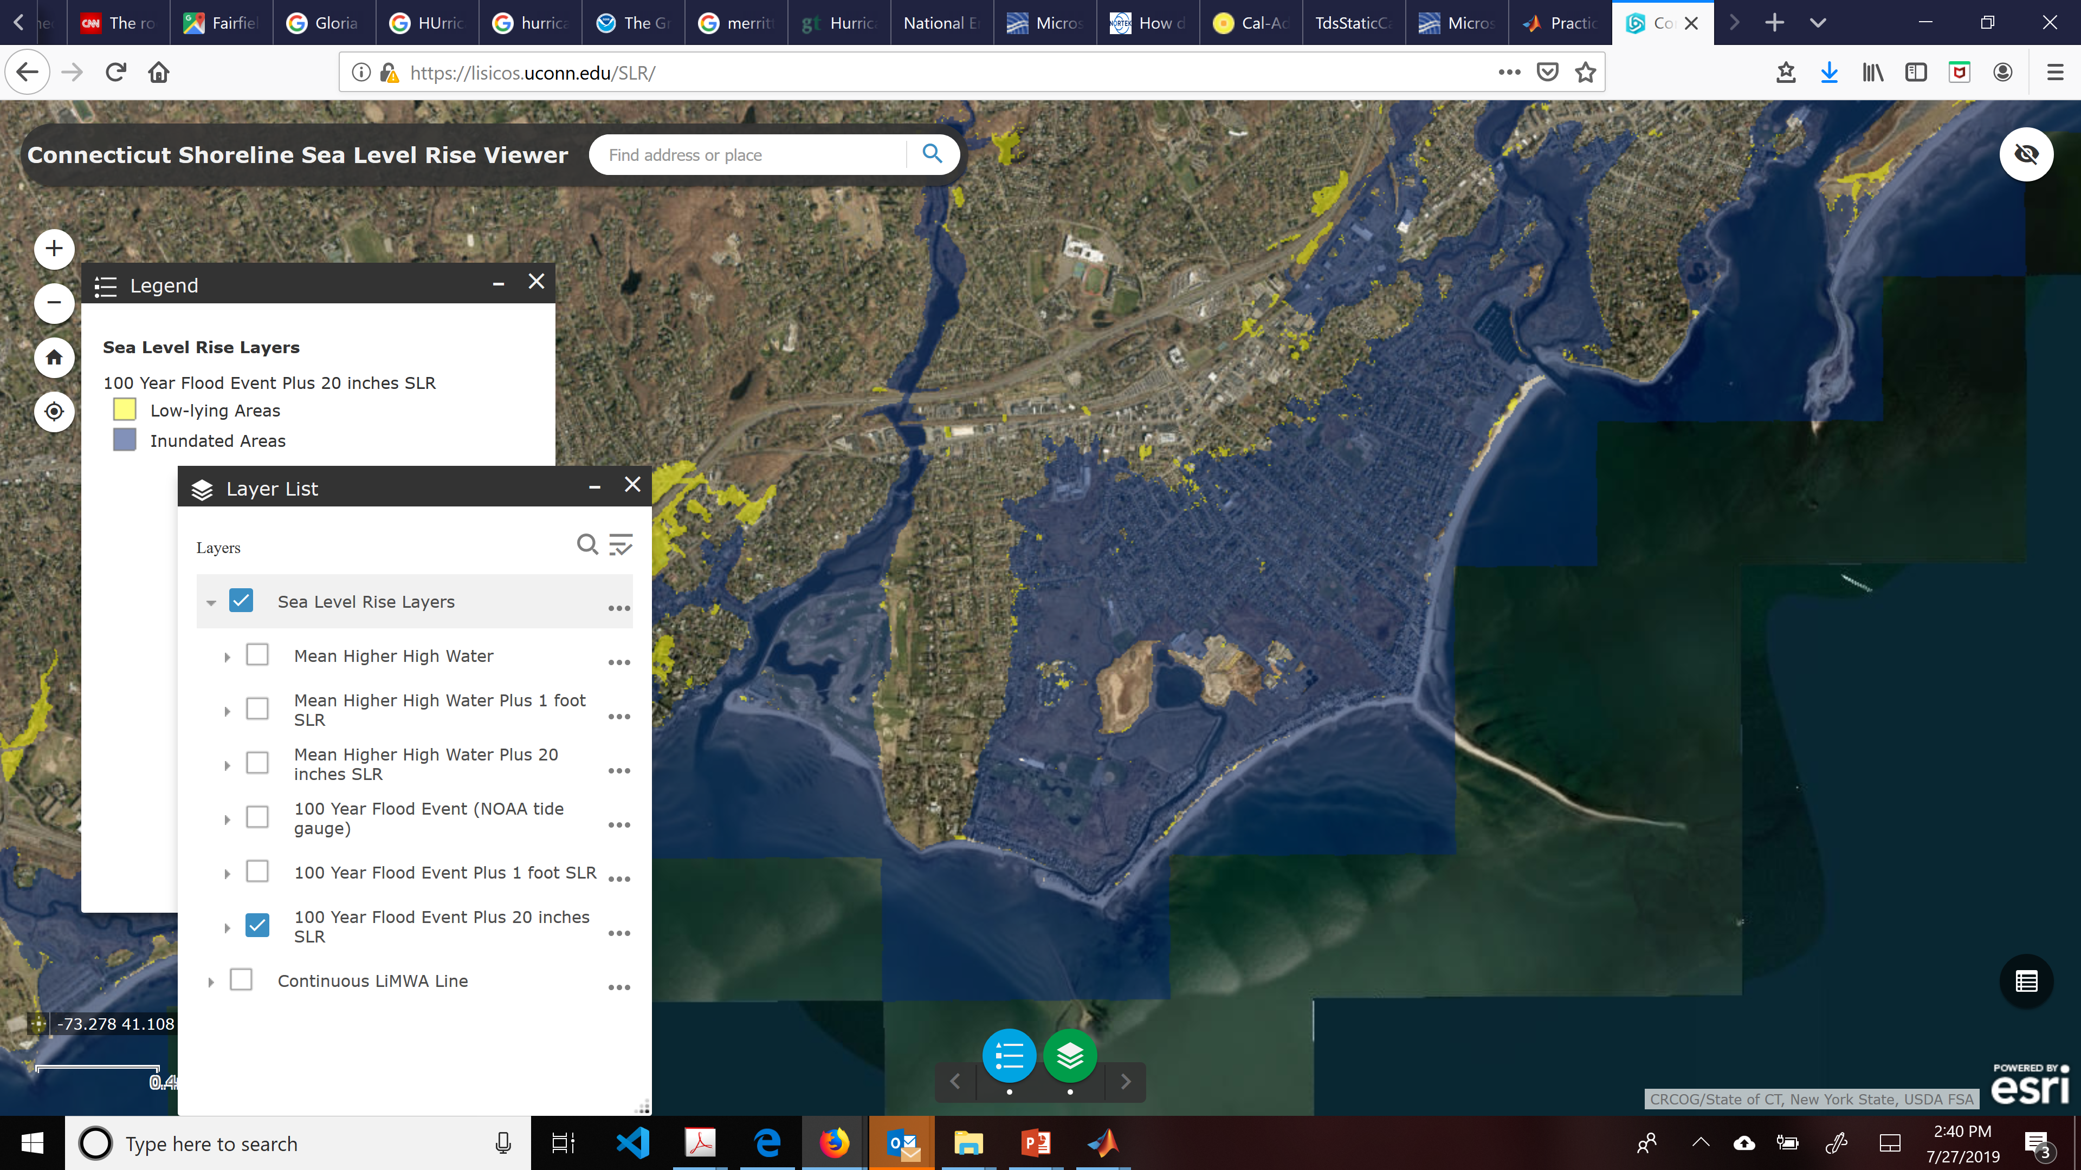
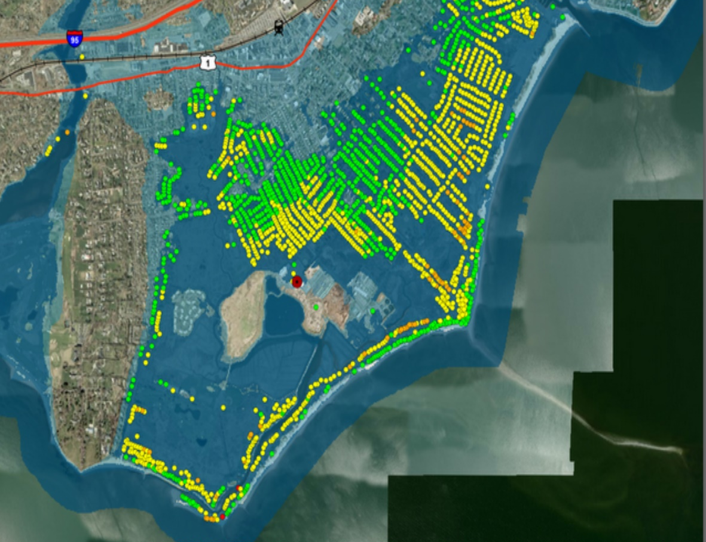
IMPACTS
Hurricanes are potential devastating and costly, but infrequent.
$675 billion in assets insured and at risk of hurricane damage on the CT coast as of 2017
Good News:
The 100 yr flood zones will not expand very much because of the geology of CT
Properties Flood in Fairfield During Sandy
Bad News:
The water levels that lead to flooding will occur more frequently.
In 2050 the risk of the flooding like occurred in Sandy could be 5-8 time higher.
https://lisicos.uconn.edu/SLR/
Notes:
These changes will have a big impact on Flood risk and Heat Stress.
The uncertainty in these projections at 2050 is not large
Increases will continue after 2050
Hurricanes in CT are already, potentially, devastating and extremely expensive
$675 billion in assets insured and at risk of hurricane damage on the CT coast as of 2017.

Slide 3
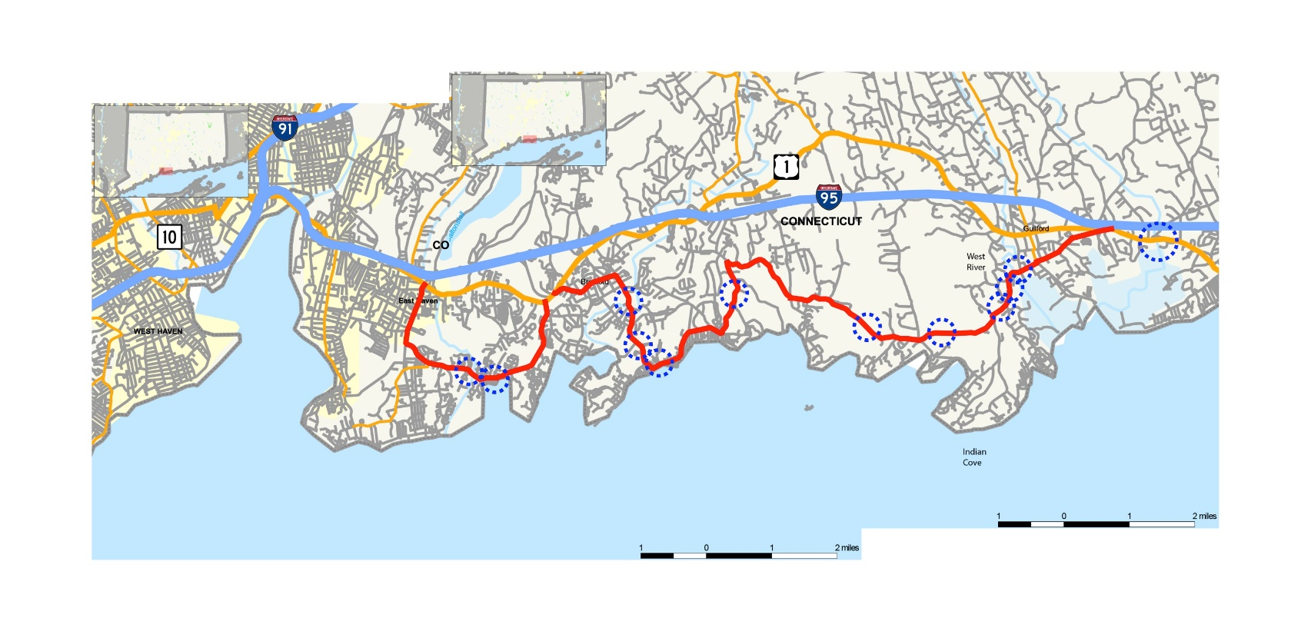
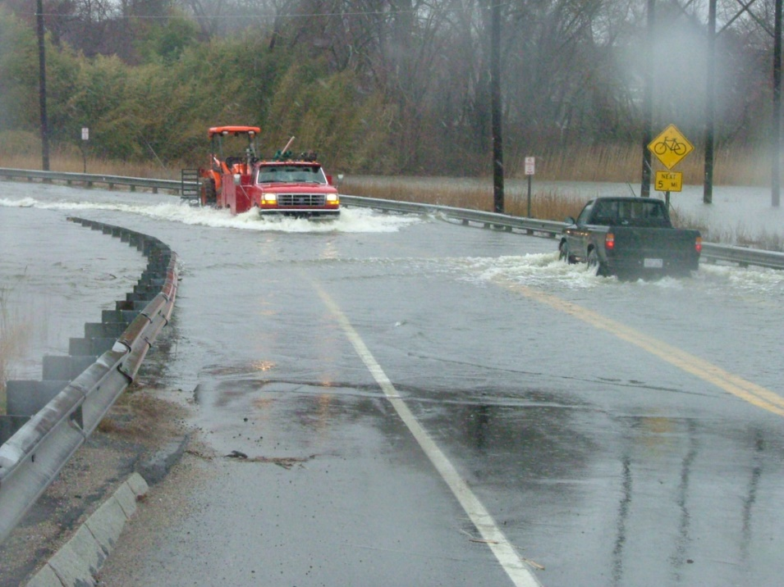
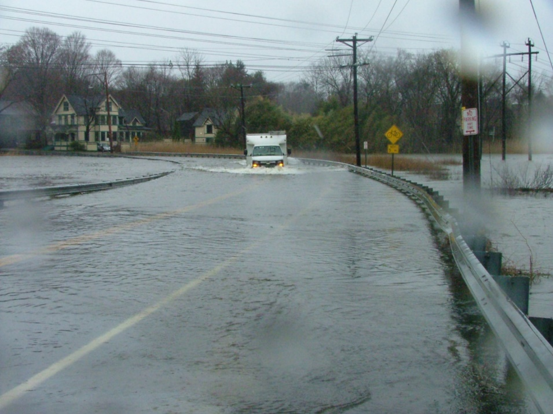
More frequent road flooding, disrupts business, e.g. RT 146
Notes:
Chronic/nuisance/tidal Flooding will also increase
Town and State roads are already experiencing this
Sea level rise will increase the cost of living on the shoreline.
The State’s strategy has been to reduce exposure by protecting critical infrastructure
Ensuring evacuation routes and Disaster Recovery Planning
Discouraging intensification of development in the (FEMA) flood plain
Public Act 18-82 requires sea level rise to be included in planning by towns and agencies with the sea level projection updated at least every 10 years.
FEMA estimate reducing risk exposure has a high (4 to 1) return on investment

Slide 4
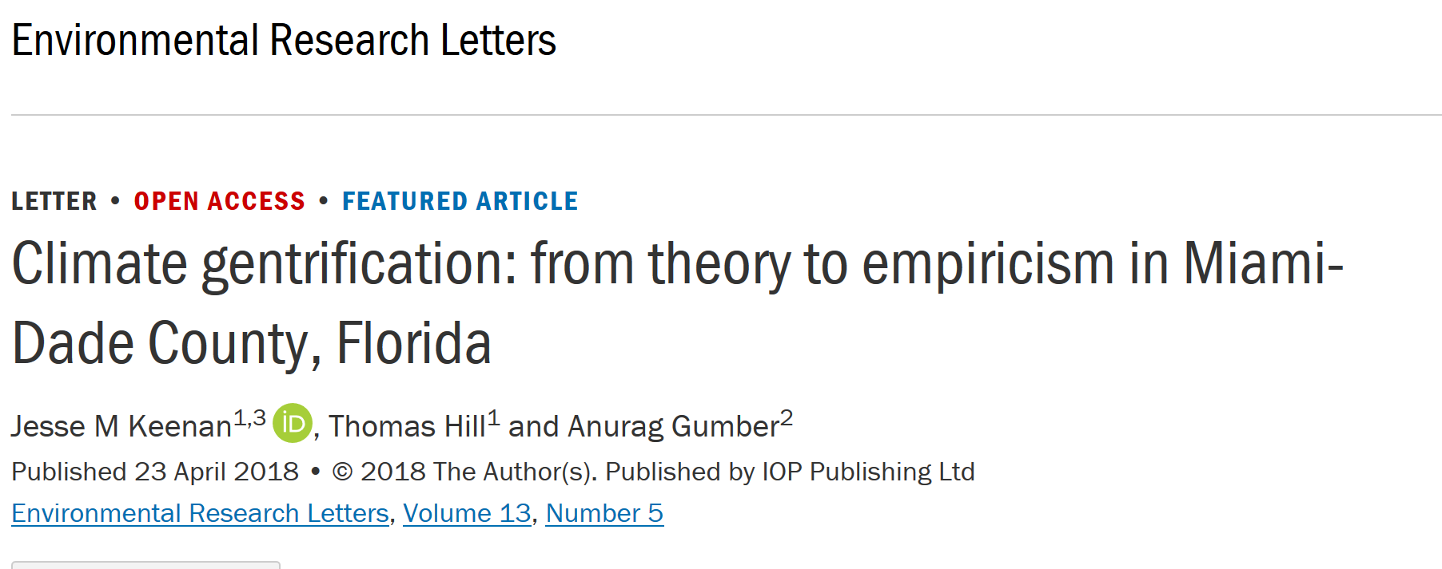
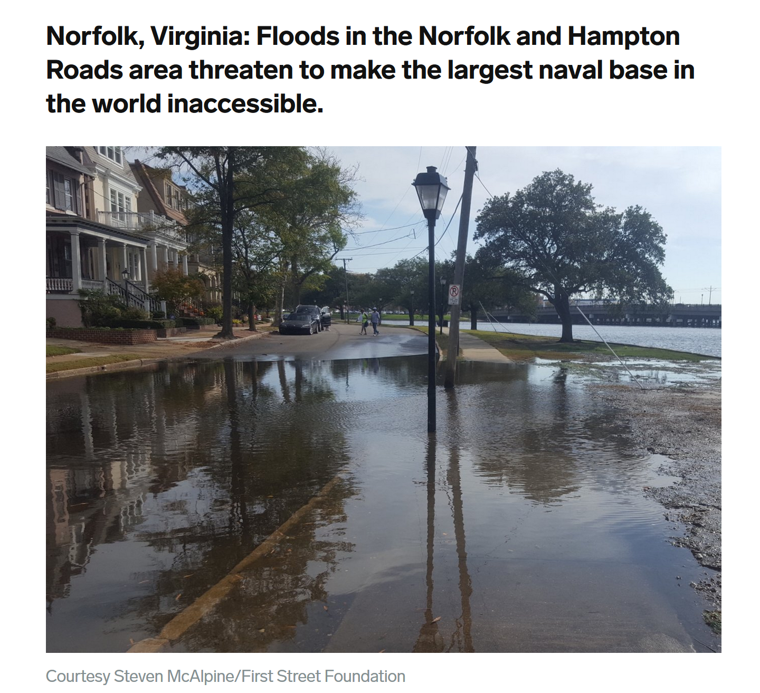
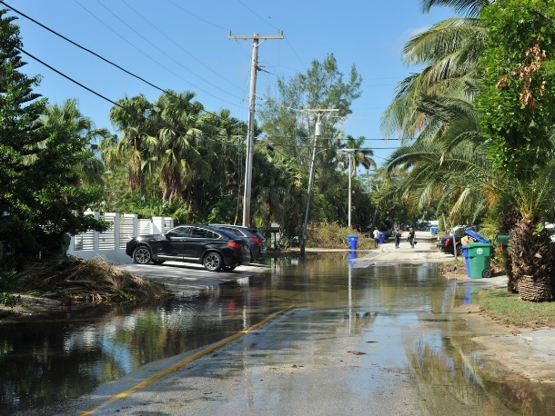
Sea Level Rise Means that flooding in coastal CT that is expected once in 10 years
should be expected every 2 or 3 years in 2050.
This will raise the cost of living bay the shore and likely impact property
values in flood prone area.
Data show this is happing in Virginia and Florida
Sunny day flooding in Miami
Reduction in value
Single Family home value index
https://www.businessinsider.com
Notes:
https://iopscience.iop.org/article/10.1088/1748-9326/aabb32
https://www.businessinsider.com/sea-level-rise-high-tides-sunny-day-flooding-coastal-cities-2018-4#san-francisco-california-many-places-havent-seen-dramatic-flooding-yet-but-high-tides-combined-with-recent-weather-show-how-quickly-waters-can-spill-over-the-walls-11

Slide 5
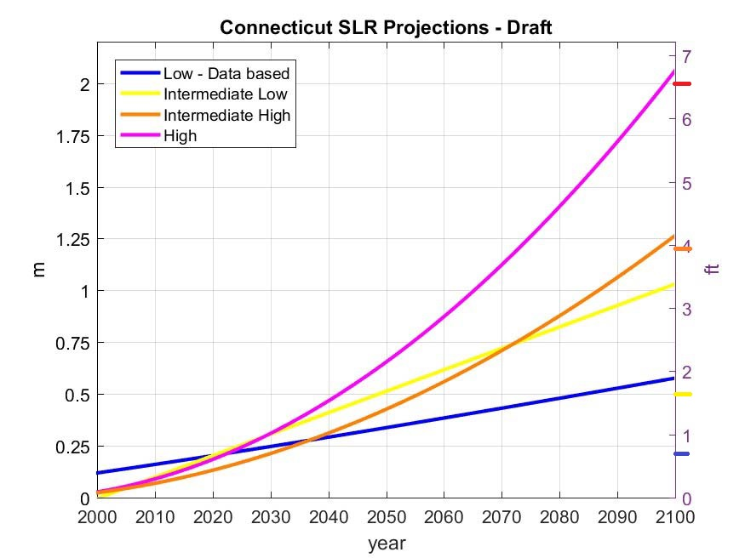
Connecticut Regional Effects
Notes:
CGS 25-68o requires UConn to Update 2012 NOAA Projections Every 10 years to reflect the unique conditions of Long Island Sound
Unfortunately, no statutory imperative to USE the UConn updates

Slide 6
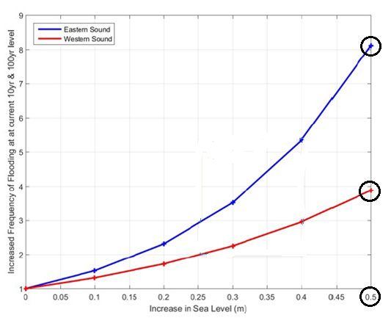
Notes:
Policy Implication 2 & 3 - 2: East-west differences 3: Storms not slow inundation
The lines depict the intersection of an increase in flood risk for a given sea level rise
Note that at 0.5 meters – one foot eight inches – western sound has 4X return rate, eastern sound has 8X return rate
As depicted on the graph, any given increase in sea level rise will increase the risk of flooding to a given elevation, and that increase will be greater in the east sound than it will be in the west.
Current 100 year flood levels return every
25 Years in Western Sound – 4x As often or 4% annual chance flood
12.5 years in Eastern Sound – 8x as often or 8% annual chance flood
SLR WILL HAVE A GREATER ADVERSE IMPACT OF EASTERN SHORELINE TOWNS THAN ON WESTERN SHORELINE TOWNS
Easiest Explanation for this effect:
The geography and geometry of Long Island Sound cause tides to be higher in the west sound than in the east sound
Tonight (02/20/18) tides will swing about 7 ½ feet in Greenwich and only about 2½ feet in New London
Adding 1 foot 8 inches to a 7 ½ foot tide has less effect than adding the same amount to a 2½ foot tide

Slide 7
Notes:
So how can towns prepare for this?
One way is by increasing the elevation of buildings in floodplains
Explain graphic:
Colors of Elevation requirements;
Note that BFE = 100 Year Flood Elevation
Limited to Residential in A and AE Zones, but similar for non-residential in these zones.
Different standards apply in VE and Coastal A “high velocity zones.”
Note that Building Elevation Requirements are Generally Higher in East Sound than in West
Animation:
Fly in east-west disparity scale
Note coincidence of building elevations

Slide 8
Public Act 18-82
“CIRCA’s current projection of 50 cm of sea level rise in Long Island Sound by the year 2050 is not a prediction, nor does it represent a mean value or likely outcome. Instead, the scenario establishes a reasonable upper bound for the purposes of adaptation planning, and by enacting SB 7, state and local agencies will employ it as a prudent, consistent benchmark for evaluating community resilience along Connecticut’s coast. “ – Testimony of Fmr. DEEP. Comm. Robert Klee

Slide 9
Preparation of POCD
CGS 8-23
POCD must take into account … “The most recent sea level change scenario updated pursuant to subsection (b) of section 25-68o, as amended by this act”

Slide 10
CGS 25-68o
Within available resources and not less than once every ten years, the Marine Sciences Division of The University of Connecticut shall [update] publish a sea level change scenario for the state based upon the sea level change scenarios published by the National Oceanic and Atmospheric Administration in Technical Report OAR CPO-1 and other available scientific data necessary to create a scenario applicable to the state coastline.

Slide 11
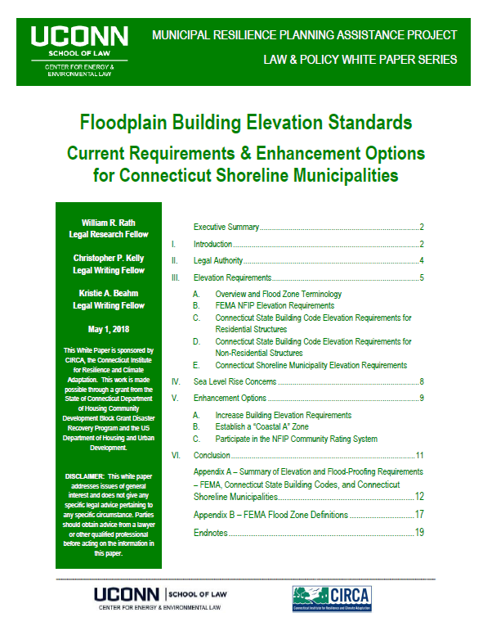
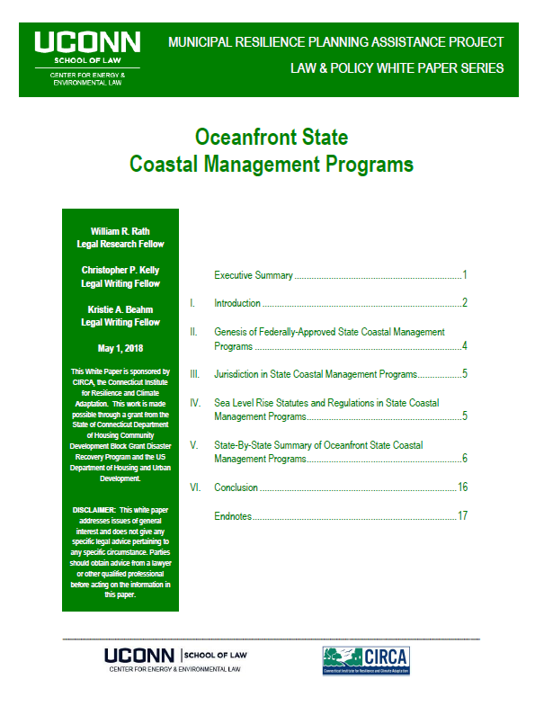
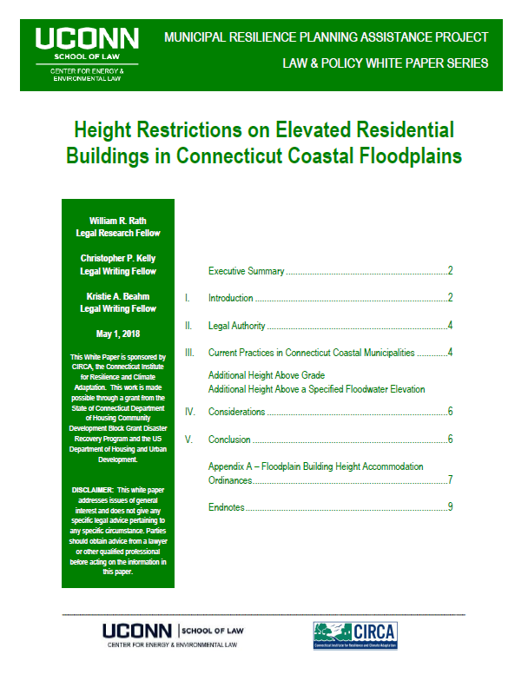
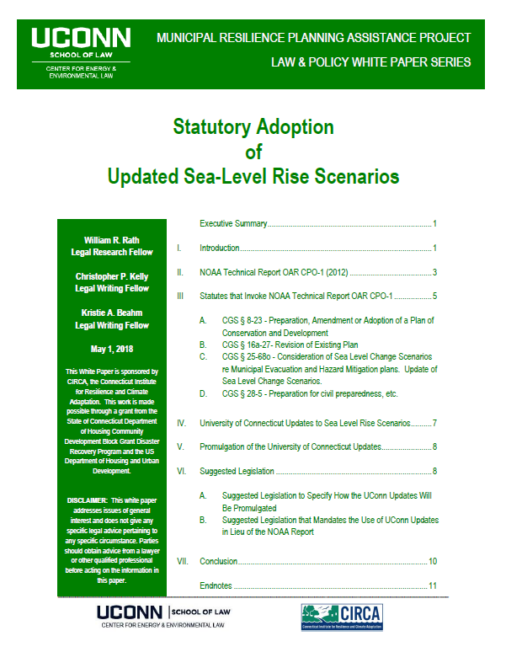
White
Papers
Notes:
Four White papers
Floodplain Building Elevation Standards
Height Restrictions on Elevated Residential Buildings in Connecticut Coastal Floodplains
Oceanfront State Coastal Management Programs
Statutory Adoption of UConn Sea-Level Rise Scenarios
A copy of each is on your table
Download your environmentally friendly copy from the CIRCA website

Slide 13
Case Study : Madison
Presentation on Zones of Shared Risk
Wide Citizen Interest
Formation of Resilience Committee.

Slide 15
